Slide 1

Dr. D.Y.Patil Institute of Engineering and Technology, Pimpri-411018.
Department of Computer Engineering
Project Presentation
on
Project Centric Mail
Presented By:
Aaditya Deshpande - 07
Ayush Agarwal - 02
Shrikant Gadekar - 03
Sunny Khandare - 06
Guided By:
Prof. Bhagyashree Bhoyar

Slide 2
Outline
Introduction
Objective
Program flow
Features
System Architecture
Software requirement specification
Advantages & Disadvantages
Applications
Conclusion
References

Slide 3
Introduction
Project Centric Mail is the way to classify the mails effectively.
It is program which filters the users mails, such that user find useful for accesing mails for any use.
There Are various features in project centric mail.

Slide 4
Objective
1. Create a user account and sign in
2. Finding the spam mail in the Gmail account
3. Clustering the mails according to the projects.
4. To identify the formality of mails.
5. To ease the usage of mails.

Slide 5
Program Flow
User Login
Authenticate user
Check For Spams
Cluster Mails according to projects
Check Formailty Of Mails
Display Results

Slide 6
Features
Spam Detection
Project Mail Clustering
Classification Of Formal And Informal Mails
Django Framework and Database connectivity

Slide 7
Features
Spam Detection:
Detection of Spam's and advertisement is done by using the concept of pattern matching
If mail contains any cyrillic character then these mails are to be classified as a Spam mail
Gmail’s Spam Detection is based on GTUBE (Generic Test for unsolicited Bulk Emails )
Notes:
<number>

Slide 8
Formal And Informal Mails:
Support Vector Machine which is supervised machine learning model is used for classification.
Sklearn python library is used for Transformers, Predicator and Pipelining.
Training set is provided to the machine and it classifies the orignal data.

Slide 9
Project Mail Clustering:
1.This feature provides grouping of similar mails of inbox which consist multivariate data set i.e. various kinds of mails.
2.Clustring is done on the basis of project names provided by the user.All the project names are initially stored into the database then it will be further used for finding mails of that respective project.
3.Grouping of mails is done by seeking the respective project name firstly in the subject of mail then in the mail body. If that particular project name is found in mail body or subject or in both then that particular mail will belongs to that respective project name.

Slide 10
Django Framework and Database connectivity
Django Framework is used for rapid development and clean, pragmatic design
Sqlite3 database is used because it is self-contained, serverless, zero-configuration, transactional SQL database engine.
Object-relational mapping (ORM) is used makes it possible to address, access and manipulate objects without having to consider how those objects relate to their data sources.

Slide 11
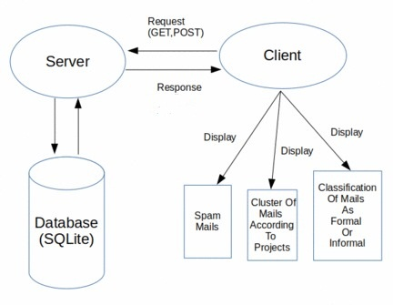
System architecture
Fig. System architecture

Slide 12
System Architecture Details
Server will host the web pages and Respond to GET and POST Request by the Client and Server will also be connected to the database .
Database will save the users information and project names. On the Client side user will be displayed the mails according to Spam , Project , Formal-Informal and user can interact with the web pages

Slide 13
Software Requirement Specification
Software requirements:
Front end: HTML,Bootstrap
Back end: Python,SQL
Frame work: Django
DBMS: SQLite
Hardware requirements:
Processor: Intel core 7th generation
Hard disk: minimum 200mb
RAM: 512MB
GPU: 2GB

Slide 14
Advantages & Disadvantages
Advantages:
1)proper grouping of mails according to project.
2)Easy the mange company,bussiness related mails.
3)Spaming mails are indentified.
Disadvantages:
1)In one iteration only 100 mails can be process ,Cost will increase to process more mail .
2)Fetching mails from gmail API are time consuming.

Slide 15
Applications
Business application:
Useful for Business pofessional and employee.
University applications:
Used by student and teachers for sorting mails of subjects and chapter.
Freelancers:
Freelancers can use it for grouping of the projects .

Slide 16
Conclusion
Project Centric Mail can found very useful to large body communities who have to handle huge number of mails everyday and; have to filter spam mails out of it wants to have cluster mails according to projects and wants to handle only formals mails.Thus Project Centric Mail(PCM) can be found useful for many purposes.

Slide 17
Refrences
1)www.esilv.fr
2)www.youtube.com
3)www.analyticsvidhya.com
4)https://docs.djangoproject.com/en/2.1/
5)www.github.com
6)www.stackoverflow.com
7)www.django.com
8)www.sqlite3.com

Slide 18
Thank You

